Slide 1

Topic: Memory Address Translation
Lecture: Dr. Zhao Jie
Date: 02/25/2026

Slide 2
Reading Assignment
Chapter 15

Slide 3
Agenda
Assembling language
ISA
Instruction in memory
Virtual and physical addresses
Base and bound
Address translation

Slide 4
Assumptions
To make memory virtualized, there are three assumptions:
Specifically, we will assume for now that the user’s address space must be placed contiguously in physical memory.
We will also assume, for simplicity, that the size of the address space is not too big; specifically, that it is less than the size of physical memory.
Finally, we will also assume that each address space is the same size.

Slide 5
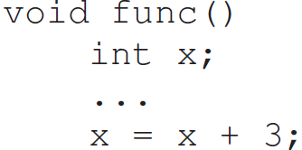
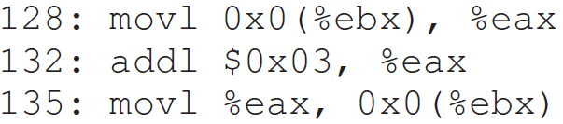
An example
Consider a simple C function
It is compiled as follows
Notification
The number of statements of the program is not the same as the number of instructions.

Slide 6
Instruction set architecture (ISA) [1]
An instruction set architecture (ISA) is an abstract model that defines the programmable interface of the CPU of a computer, and how software can control a computer.
In general, an ISA defines the instructions, data types, registers, the hardware support for managing main memory,[clarification needed] fundamental features (such as the memory consistency, addressing modes, virtual memory), and the input/output model of the programmable interface.
An instruction set architecture is distinguished from a microarchitecture, which is the set of processor design techniques used, in a particular processor, to implement the instruction set.
[1]. https://en.wikipedia.org/wiki/Instruction_set_architecture

Slide 7
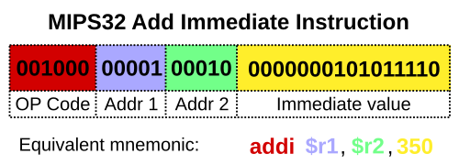
Instruction set architecture example [1,2]
Practice: What is the functionality of the following instruction?
Syntax [2]
[1]. https://en.wikipedia.org/wiki/Instruction_set_architecture
[2]. https://msyksphinz-self.github.io/riscv-isadoc/#_addi

Slide 8
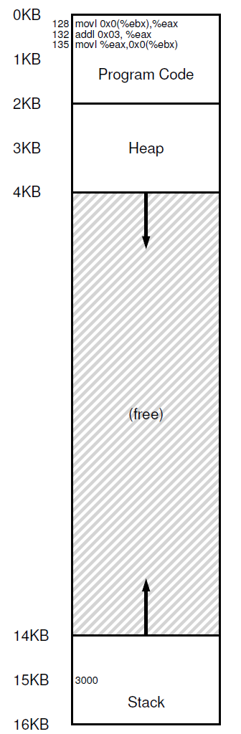
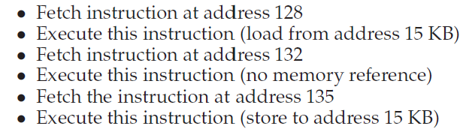
The example with memory consideration
The example instructions
How to work

Slide 9
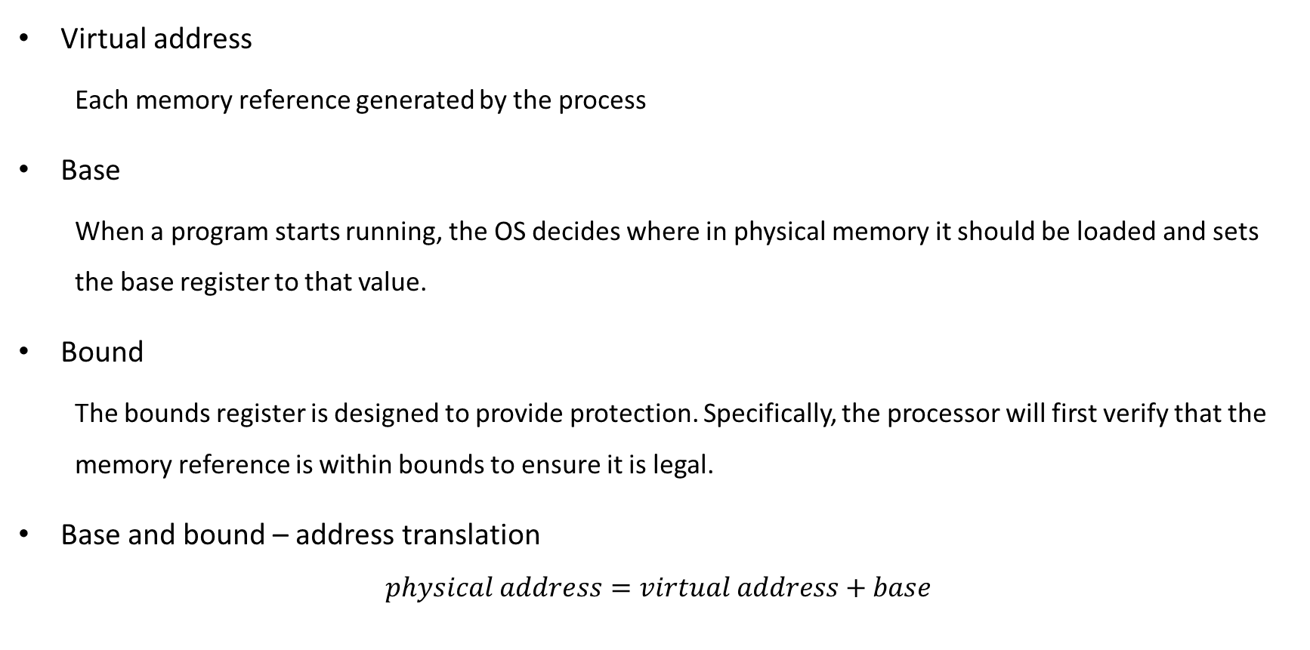
Dynamic Relocation(why so called?)
Virtual address
Each memory reference generated by the process
Base
When a program starts running, the OS decides where in physical memory it should be loaded and sets the base register to that value.
Bound
The bounds register is designed to provide protection. Specifically, the processor will first verify that the memory reference is within bounds to ensure it is legal.
Base and bound – address translation
$$physical address=virtual address+base$$

Slide 10

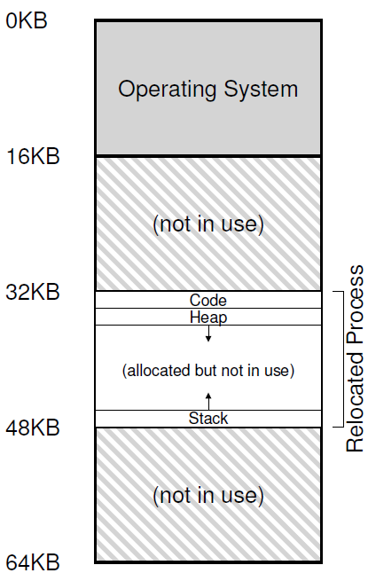
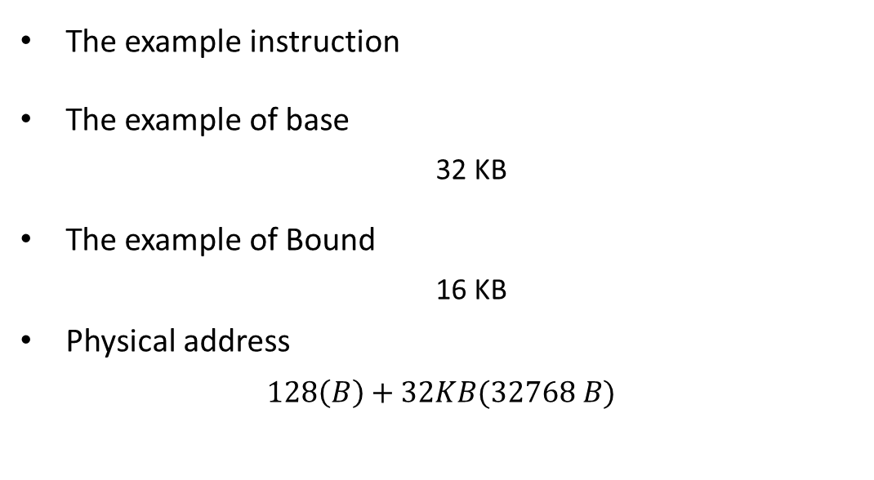
Address Translation - 1
The example instruction
The example of base
32 KB
The example of Bound
16 KB
Physical address
$$128\left(B\right)+32KB(32768 B)$$

Slide 11
Address Translation - 2
Practice: Given the dialog on the right, what are the physical addresses for the following two instructions? (Before calculation, please decide the base and bound first. )
Example 1:
Example 2:
Example 3: VA: 16,500 (B)

Slide 12
Role of hardware in translation
CPU provides the privileged mode of execution
Instruction set has the privileged instructions to set translation information (e.g., base, bound)
Hardware(MMU) uses this information to perform translation on every memory access.
MMU generates faults and traps to the OS when access is illegal. (e.g., VA is out of bound)

Slide 13
Role of OS in translation
OS maintains a free list of memory
Allocates space to process during creation(and when asked) and cleans up when done
Maintains information on where space is allocated to each process (in PCB)
Set address translation information (e.g., base & bound) in hardware
Updates this information upon a context switch
Handle traps due to illegal memory access

